Slide 1
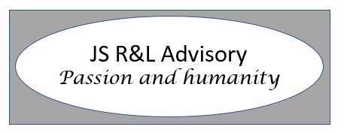
Emotional intelligence (EQ)
Free training material

Slide 2
Disclaimer
This presentation is drawn from open-source material that has been referenced, as well as the author’s experience managing both himself, his own emotional intelligence and working with teams across multiple cultures in assisting others develop their emotional intelligence competencies.
The author takes no responsibility for the results from the use of all or part of thisd free presentation.
The author has no psychology qualifications, nor claims to have any.
The author has read widely on this subject as part of his own journey in leadership over many years as well in his life-long struggle with high functioning depression (HFD).
The material is free to use as whole or in parts, with the Author being referenced when the product is in use.

Slide 3
Learning objectives
Understand the elements of emotional intelligence (referred to as EQ)
To be able to apply the elements in and out of work
To understand methods to assess yourself objectively on your level of emotional intelligence
To understand methods to invite others to assess you objectively
To being able to learn the elements on emotionally intelligence through knowledge and experience
To be able to define your own journey to improve your emotional intelligence

Slide 4
What is EQ
In 1990, psychologists John Mayer and Peter Salovey of Yale theorized that there was an intelligence underlay other skill sets. They coined the term, emotional intelligence (or emotional quotient) , which they broke down into four “branches”:
Identifying emotions on a nonverbal level
Using emotions to guide cognitive thinking
Understanding the information emotions convey and the actions emotions generate
Regulating one’s own emotions, for personal benefit and for the common good
As a science reporter for the New York Times, Daniel Goleman was exposed to Mayer’s and Salovey’s work and took the concept of emotional intelligence a step further. In his book from 1995, he argued that existing definitions of intelligence needed to be reworked. IQ was emotions. IQ, he argued was still important, but intellect alone was no guarantee of our capability to identify our own emotions or the emotional expressions of others. It took a special kind of intelligence and that is Emotional Intelligence or EQ (Emotional quotient)

Slide 5
EQ for everyone
Emotional Intelligence is not the sole domain of leaders.
It is a set of universal competencies in life and work, and everybody has the right and indeed the need to consider emotional intelligence competencies.
This presentation will give a greater level of attention to those competencies that are “life” skills whilst still staying true to Goleman’s 12 competencies.
High EQ comes with many benefits some of which are shown below:
Better communication
Stronger empathy
Quality leadership skills
Healthier relationships with yourself and others
Improved problem-solving and conflict management
Improved decision-making
Positive improvements to your overall well-being
Cleveland Clinic 2025
What Your Emotional Intelligence Means for You

Slide 6
EQ for everyone
Is EQ essential for leadership?
This is matter widely researched and some would argue that the answer is “yes” and others “no”.
The author of this presentation distinguishes between:
sustainable leadership (long term steady performance through others)
unsustainable leadership (short term results and/or erratic performance)
And argues that Sustainable leadership of people and business performance is always going to be enhanced when the leader has a good level of emotional intelligence.
This presentation will not look at leadership styles outside the subject of EQ

Slide 7
Goleman’s Four Pillars of EQ
The model looks at SELF and SOCIAL
Self is all about you or me
Social is your awareness and competency in understanding and reacting to the emotions and others, and your impact on others.

Slide 8
In work and out of work
Emotional intelligence is NOT a work capability or competence, but a set of competencies for life. Goleman focuses on the work place; however, an emotional intelligent person is likely to be a more inspirational and brighter person to be around wherever they are.
An emotionally intelligence person will behave towards self and others the same way in and out of work, and most importantly at home, with family and friends.
PLEASE remember if you pretend to be somebody you are not in your work life, this will cause you stress and will simply not help your performing at work, as you’ll be worried the “mask” will fall.

Slide 9
Twelve Competencies of EQ
Self Awareness
Emotional self awareness
Self management
Social awareness
Relationship Management
Emotional balance
Adaptability
Achievement orientation
Positive outlook
Empathy
Organisational awareness
Inspirational Leader
Influence
Coach and mentor
Conflict management
Teamwork
Goleman with Boyatzis then developed the 12 competencies of Emotional Intelligence again under Self and Social that are shown in many ways.
As SELF AWARENESS underlies all other competencies, the Author has displayed the competencies as in this slide
Goleman and Boyatzis (2017)

Slide 10
You can learn EQ
The wonderful news for all of is that we learn emotional intelligence.
Our brains are “plastic” and can be molded through gaining knowledge and coupling this knowledge with experiences.
Through practicing competencies such as self management, positive outlook and empathy, we can actually increase the number and efficiency of neurons in the parts of the brain that control these competencies and over time the way in which you behave and react with these competencies becomes a part of you.
And then we need to maintain and continue to build on these competencies as we follow the rule set out in the book A Brain That Changed Itself (Normal Doidge 2007)
“use it or lose it”

Slide 11
How we learn
Three Stages of Learning:
Encoding: Initial Learning - where your brain takes in new information. Paying attention is key at this stage because the brain decides which information to store and which to ignore.
Consolidation: Strengthening Memories - After learning something new, the brain strengthens the memory during sleep or rest. The hippocampus in your brain plays a big role in this, turning short-term memories into long-term ones.
Retrieval: Accessing Learned Information - Once a memory is stored, the brain retrieves it when needed. The more you practice or recall the information, the easier it becomes to access. This is why repetition is important for solidifying what you’ve learned.

Slide 12
Four ways of learning
Declarative Learning (Explicit Memory) - learning facts and information you can consciously recall. For example, remembering a historical date or a math formula involves declarative learning.
Procedural Learning (Implicit Memory) - learning tasks through repetition without much conscious effort. For example, typing on a keyboard becomes second nature over time.
Emotional Learning - the amygdala, the part of the brain responsible for emotions, plays a role here. When you have a strong emotional reaction to something, the brain is more likely to encode it.
Social Learning - happens when you observe and imitate others.
Improving your emotion intelligence over time will occur primarily through emotional and social learning, which is why it so important to choose emotionally intelligent people to learn from.

Slide 13
And now what?
So What?
What are we going to do with these competencies?
How about sitting down quietly and asking yourself how would you score yourself if asked about your competency in each area
This not a competition, it is a critical part of your very own improvement, a journey in life. The road is long so go slow and be cautious.
We’ll talk about PACE and INVITING OTHERS IN later in the presentation

Slide 14
Let’s get started
Using the 12 competencies. We can acknowledge the competencies, but they are of little use unless we can assess ourselves against them and build on what we have already.
Self- Awareness | 1-5 | Self-Management | 1-5 | Social Awareness | 1-5 | Relationship Management | 1-5
Emotional self-awareness |  | Emotional balance |  | Empathy |  | Influence
 |  | Adaptability |  | Organisational awareness |  | Coach and mentor
 |  | Achievement orientation |  |  |  | Conflict management
 |  | Positive outlook |  |  |  | Teamwork
 |  |  |  |  |  | Inspirational leadership
The simplest way to score yourself is to think 1 to 3 or 1 to 5, where 5 means I am as good as I can be in that competence.
Now it is a little “chicken and egg” here as to score yourself well, you need to be self aware.

Slide 15
Scoring and colour
As we grow, we are taught to associate colours with emotions, and indeed there is an entire science concerning colours and emotions.
In many societies the colour “red” becomes associated with danger and “bad”, whereas “green” is for “go” and is a good colour, in tune with nature.
In business and industry and notably in risk management and heat maps we learn “Red” is bad, “Green” is good, and then there is range of colours between these.
If we score ourselves at “1”, and use red, then it can indicate we are bad. This is not the case with emotional intelligence. It means that we have a competence we need to improve on and that we are being honest or maybe even too pessimistic.
If you choose to use colours, then choose positive colours throughout please.
1 | 2 | 3 | 4 | 5

Slide 16
Self Awareness
You need to be self aware to attempt an accurate assessment.
We all think and behave in different ways.
We are products of our past experience and genetics (nature and nurture)
Some people find it easier to be honest with themselves than others.
IF you are scoring yourself a “5” for everything you need a reality check. Not even the most emotionally intelligent people on earth would score themselves a “5” in every competence.
IF you are scoring “1” in everything you are probably putting yourself down and not acknowledging your positive areas.
You may need to score yourself one day and then come back to your self assessment in a few days time having thought about them more (but don’t overthink them please.

Slide 17
Self awareness
It is often helpful to put some words around the numerical scores to help with the assessment.
Even with the accompanying words, self honesty is critical.
Let's have a go at some words below that define 1 to 5 for “emotional self awareness”
Self- Awareness | 1 | 2 | 3 | 4 | 5
Emotional self-awareness | I struggle to be aware of my own emotions | There are times when I am aware of my emotions | I am aware of my own emotions more often that not | I am aware of my own emotions much of the time | I am fully aware of my own emotions at all times
How do I know if I’m aware of my own emotions.

Slide 18
Building self awareness
As self awareness is the basis of all emotional intelligence it is critical that we all, however competent we are or may feel we are, continue our journey to build self awareness. There are many ways to improve over time, a few are mentioned below:
Keep a journal of your thoughts and feelings.
Ask for constructive feedback from others on a regular basis and not just at appraisal times.
Practice mindfulness – try meditating.
Listen actively without constructing your response until you have heard the full statement/sentence/request/point.
Pay careful attention to your thoughts and emotions.
Pursue your passions and do what makes you happy.
Learn new skills and set SMART goals for you.
Reflect on your own day and experiences and find ways to be grateful.
Use positive self-talk daily towards others and yourself.
Many of us are too good at criticising ourselves, try finding positives.

Slide 19
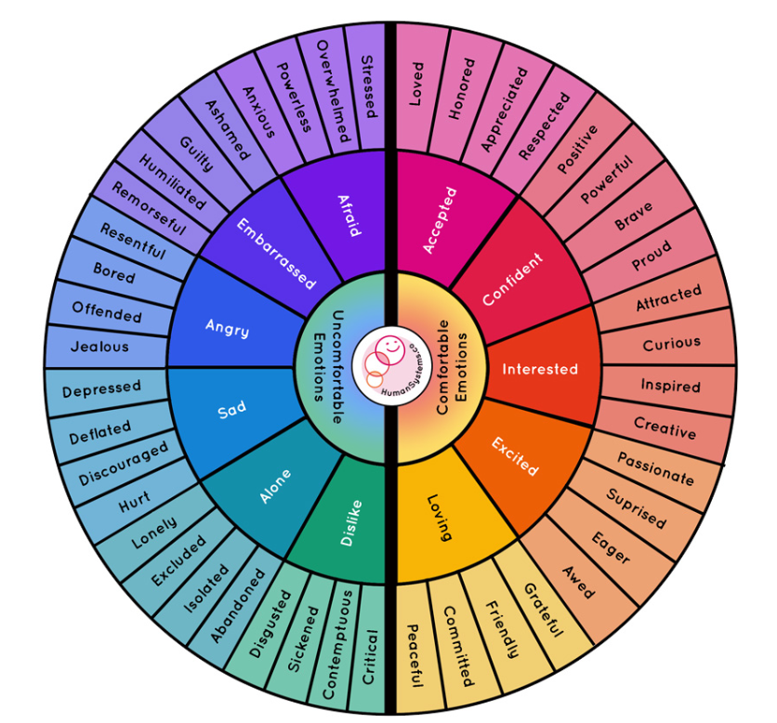
Aware of my emotions
The feelings or emotions wheel was originally developed by Gloria Wilcox in 1982 and has been adapted many times for many different purposes.
It is commonly used in therapy sessions and journalling emotions to put into words how you are feeling.
Try printing this wheel and identifying your emotion at different times of the day and in different environments. Nobody need know you are doing this if you don’t want them to.
This way you will start to be able to put words around your own emotions and become more self aware.
https://ar.inspiredpencil.com/pictures-2023/feelings-wheel-printable

Slide 20
Self Management
Emotional balance – your ability to soften your response/reaction (where you need to) to your emotions. At times we all get: angry, sad, frustrated, upset and
Emotional Balance
Self management
Emotional balance
Adaptability
Achievement orientation
Positive outlook
more (see the feelings wheel), however if we allow these emotions to be the sole controller of our reactions, we may alienate others, or even scare them.
There are times when we need to vent and let our emotions spill over, but choosing these times and with who and where is important.
If a colleague in a meeting has angered you, jumping up from your chair and screaming at them is clearly not emotional self control. Taking a few seconds to compose yourself and your thoughts and responding calmly and politely, if any response is needed at all, is powerful.
The more you practice taking a moment and the other EQ elements this, alike the other competencies will become how you behave without thinking

Slide 21
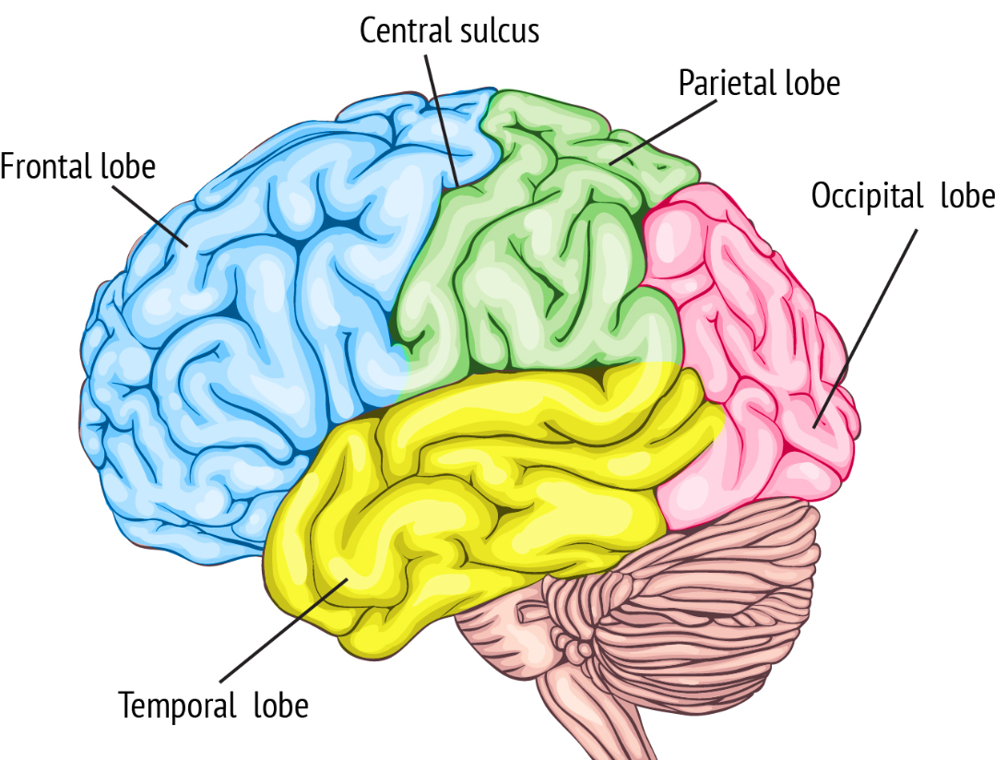
Our brains can soften reactions
The “new brain” or frontal lobe is the secret to softening our reactions to emotions.
Our brain’s frontal lobe is home to areas that manage thinking, emotions, personality, judgment, self-control, muscle control and movements, memory storage and more.
Your frontal lobe handles many abilities, including:
Reasoning: simple and complex processing of information. Logic, reasoning, judgment, decision-making and creativity all fall into this category.
Social understanding: your understanding of social norms and helps determine what you should and shouldn’t do or say.
Executive functions: self-control and inhibitions, attention span and working memory.
Learning and recalling information: your brain’s ability to process and learn new information for later use. Your frontal lobe also helps retrieve information later.
(Cleveland clinic 2025)

Slide 22
Self Management
Self management
A work place devoid of emotions would be a rotten place to work, unless you are a robot.
A work place of extreme emotions would also be a difficult place to work as well.
We need to aim for a balanced set of positive emotions, across the right-hand side of the feelings wheel to the greatest extent, understanding that controlled frustration also has a place in the work place, a place where people can be constructively honest with each other.
We’ll talk more on this in “conflict management” later in the presentation

Slide 23
Self Management
Adaptability
MIT Sloan defines AQ or adaptability quotient as "the ability to rewire your behavior in real time in response to rapidly changing environments.
The world we live in, and to some extent, have lived in, is one of change. Change in our personal lives, our own development, in the world around us and far as well as the world of work. The acronym VUCA is for: Volatility, Uncertainty, Complexity and Ambiguity, which aptly describes the world we live in. (originally used by US War College in the Cold War)
There is adapting to “cope” and adapting to “win”.
Self management
Emotional balance
Adaptability
Achievement orientation
Positive outlook
Adapting to cope is often necessary in times of rapid and threatening change.
Adapting to win is characterized by the following traits in a person and are very sought after traits by employers:
Problem solving | Innovation | Continuous improvement
Curiosity | Mindfulness | Willingness to make mistakes
Creativity | Learning mindset | Unafraid of the unknown
Consideration for the future
Predictive index.com 2025

Slide 24
Self Management
Achievement orientation
This competence has positives and negatives.
Self management
Emotional balance
Adaptability
Achievement orientation
Positive outlook
It looks at your ability to drive towards challenging goals, called “stretch” goals in some companies. Clearly, we seek people in companies who are driven to achieve challenging goals. These can be achieved by:
Doing work more efficiently
Doing work in innovative ways
And these can apply to life, where a person strives to achieve ever greater goals.
HOWEVER, if you consistently drive others harder, faster and longer with no mix of other competencies such as empathy, you can quickly become a toxic leader or colleague.
If you constantly, without breaks and “happy times”, drive yourself, this is a quick way to burn out, which very quickly diminishes your performance or puts you out of the work place temporarily or permanently.
Many people only consider BIG achivements, but it is better to consider celebrating and recognizing on yourself and others, the smaller and more frequent achievements/wins if you want to cultivate this competence.

Slide 25
Self Management
Positive Outlook
Goleman defines positive outlook as “the ability to see the positive in people
Self management
Emotional balance
Adaptability
Achievement orientation
Positive outlook
in situations and events. It means persistence in pursuing goals despite setbacks and obstacles, you can see the opportunity in situations where others would see a setback that could be devastating, at least for them.”
We all have rotten days and good days in life, in and out of work. The author considers this competency from work and out of work angles.
Once again, we can train ourselves/brains to be more positive and to seek the positives in all situations.
If you make a mistake at work and you learn from it, despite the potential outcomes, the positive is that you learned and have an opportunity to avoid that mistake again.
The more you practice being positive the more you feed your reward cycle (see next slide)

Slide 26
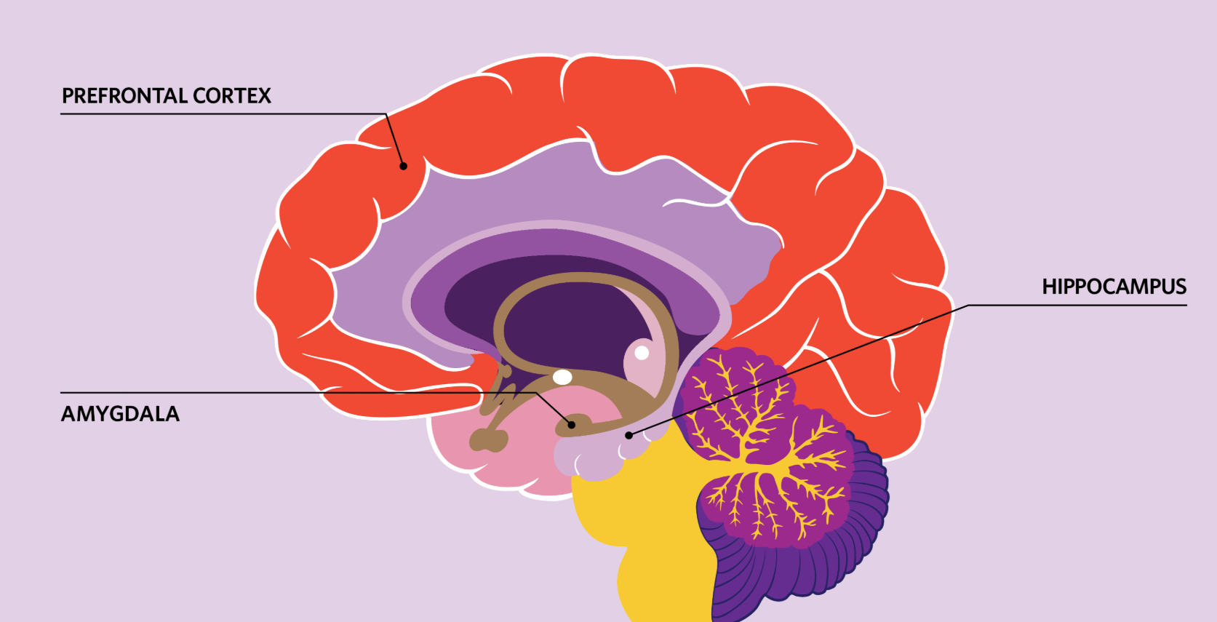
The reward cycle and learning
This is a VERY simplified explanation of the reward cycle for the purposes of better understanding how we learn best
When the brain receives a stimulus from one of our senses or from an internal thought The hippocampus provides context from past experience and the amygdala adds emotional significance.
If the stimulus is recognized as rewarding neurons are stimulated to release dopamine, which is one of many neurotransmitters (transmitting signals throughout our brain and body).
In another part of the brain the dopamine produces changes in neurons that correspond to feelings of pleasure and reward.
ar.inspiredpencil.com
The burst of dopamine sends a signal to the prefrontal cortex (the part of the brain involved in decision-making and planning), which helps us link the reward to what we did to get it and makes us more likely to repeat this behaviour.

Slide 27
Social Awareness
Empathy
Empathy is your ability to put yourself in somebody else's position and to understand their emotional state. This capability is a complex series of interactions between different parts of your brain, and is shaped by our own experiences.
If you have never experienced grief from the death of a family member it is difficult to understand the emotions of others in this situation, however you have been sad, and this helps to transpose yourself into their position.
Social awareness
Empathy
Organisational awareness
Without empathy, we cannot hope to interact with those around us at work and out of work, reacting in an appropriate manner.
Just as someone may be sad, they may also be angry at not receiving the bonus they think they deserved. If you miss this clue, then you may well just anger the person more through an unsympathetic conversations full of facts and emotion. As you work through your career, empathy will be critical with peers, reports and those you report to, as we all have emotional states that can be triggered by multiple factors in and out of work.

Slide 28
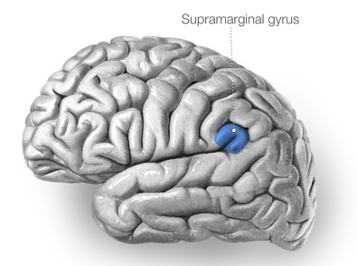
Social Awareness
Empathy & Compassion
The Author puts Empathy, next to Compassion. Compassion is our ability to not only empathise, but feel a sense of “togerthness” in the emotion of another.
Empathy and compassion do not require you to know a person or a group of people, but to understand, through your own experience their emotional states.
Recent studies have shown that the right Supramarginal gyrus (in the brain) is responsible for helping us to be able to distinguish our emotions from another persons. It enables “me” to decouple for “you” or “them”.
When we take quick decisions, we are far less likely to be able to understands another person's emotions within that process, which means that empathy needs careful considered decisions to be made.
How we empathise and show compassion could be a presentation all of its own, owing to this complex subject, but we need to move on.

Slide 29
Social Awareness
Organisational awareness
Unless you work for you alone, devoid of contact with others, you need to
Social awareness
Empathy
Organisational awareness
understand the dynamics of an organisation, that can be complex.
There are multiple cross relationships between teams, functions and levels, and this dynamic is impossible to write down
You can ask yourself a mountain of questions to gain this understanding, however there will never be a substitute for engaging and observing the dynamics. Some will become aware of the organisations dynamic quickly and others not so quickly.
This competence is routed in self awareness, being aware of your emotional state and observing others, occasionally having to silence your response to better understand how others respond to others.

Slide 30
Relationship management
Inspirational Leader
This slide could easily be 10 slides or more on its own as a subject.
Relationship Management
Inspirational Leader
Influence
Coach and mentor
Conflict management
Teamwork
The easiest way to start on this subject as an individual is to think of a leader in business, and I purposely stick to business, who is greatly admired by many people because of their ability to help people and businesses grow, and who bring “good” to the world.
Kathy Lockwood in Forbes (Forbes.com) talks about 6 traits of inspirational leaders
1. They are calm in stressful situations.
2. They show their human side.
3. They listen and accept feedback
4. They are resilient.
5. They show integrity.
6. They develop talent.
The Author has added a 7th and that is Passion. Passion for the business, the purpose of the business and a passion for developing people and enabling those they come into contact with to be successful.
Influential leaders also surround themselves with alternate views, ensuring that there is challenge and continuous learning and innovation. Inspirational leaders are emotionally mature.

Slide 31
Relationship management
Influence
Do other people want to do what you want them to, now or later. If the answer if “yes”, then you have influence.
Influence can be given through your position (positional influence), such as you are the manager, however this is by FAR the weakest of influence.
Relationship Management
Inspirational Leader
Influence
Coach and mentor
Conflict management
Teamwork
Personal influence is much more powerful and can be characterized by
Effective communication skills
Ability to inspire action
Understands our culture
Upbeat and optimistic
Authenticity
Able to build collaboration & unity
Solid ethical foundation
Your influence will also come from your Self Awareness and Social Awareness. Without these, it is difficult to be influential.

Slide 32
Relationship management
Coach & Mentor
Without coaches and mentors in an organisation. People who are emotionally mature, and who understand the business and the organizational dynamics, development of people in the company is difficult.
Relationship Management
Inspirational Leader
Influence
Coach and mentor
Conflict management
Teamwork
Let’s use the term “coach” for simplicity. The simple question is would you like to learn from a person who thinks of themselves all the time and doesn’t actively listen, OR from somebody who is able to empathise, listen, understand your questions and challenges and who can suggest ways you can work and think to overcome the challenges, or to build on existing competencies.
Clearly the answer is the second type of person.
Through coaching a person, you learn a lot about yourself and your emotional intelligence as you help the other person to progress in their competencies in all fields (emotional and technical) .

Slide 33
Relationship management
Coach & Mentor
We tend to associate a coach and mentor with work life.
Relationship Management
Inspirational Leader
Influence
Coach and mentor
Conflict management
Teamwork
However, we need to start thinking about life outside work in the same way. WE can invite people to coach and help us outside life, sometimes in a formal way, maybe through a life coach or therapist.
However these are costly routes in many societies, and we can substitute these through asking trusted people in our lives to give us feedback and to suggest ways of tackling challenges.
IT IS CRITICAL that if you are suffering from any form of mental illness or disorder such as mild or severe anxiety, depression or other illness that you seek professional help and that you seek this help as soon as possible.
The Author delayed getting any help and talking to anybody, despite knowing that their mental state was deteriorating, and has suffered life long impacts from the denial and delay.

Slide 34
Relationship management
Teamwork
If you and a colleague were to pick two teams for an event at work, would people like to join your team?
Do people want to join your department?
Your ability to work in a team, if you are the leader or not, is critical in life and work.
Self management and Social awareness are important if you are going to be a good team player and/or fit into a team.
A team is made up of individuals, who are all different in nature and nurture. There will be dynamics, friendships, frustrations, conflicts and more, and your ability to effectively navigate through and work alongside all these dynamics is needed to be in a team.
Relationship Management
Inspirational Leader
Influence
Coach and mentor
Conflict management
Teamwork
The most important element for any team is a common understanding of purpose and direction coupled with a clear understanding of the goals of the team and how they achieve the purpose. Goals for individuals and team must be Specific, Measurable, Achievable, Realistic and Time bound (SMART)

Slide 35
Relationship management
Conflict Management
Conflict in teams, companies and indeed life, is inevitable.
Relationship Management
Inspirational Leader
Influence
Coach and mentor
Conflict management
Teamwork
The word conflict may be associated with violence, however in this sense we are looking at disagreements that are not immediately or easily resolved by two people, or more. They can occur for many reasons with a few listed below:
Misunderstandings
Poor communication skills
Differing opinions, viewpoints, or personalities
Biases or stereotypes
Perceptions of unfairness
The Thomas-Kilmann Conflict Model outlines five strategies for conflict resolution which each has a place in life and business.:
Avoiding Competing Accommodating Compromising Collaborating

Slide 36
Relationship management
Conflict Management
Compete
Your goal is all important to you
Often nt suited to the work place
Collaborate
“win win” your goal and the relationship are equally important
Compromise
“lose lose” neither party wins but the relationship can stay strong
Assertiveness
The importance of your goal
Accommodate
The relationship mis more important than your goal
Avoid
Neither the goal nor relationship are important to you
Strategies more suited to the work place
Cooperative
The importance of this relationship

Slide 37
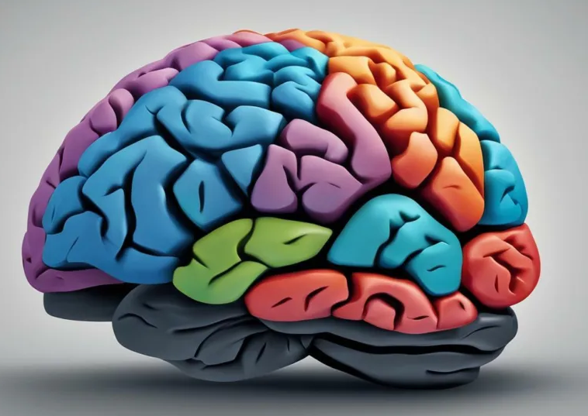
Pace of change
Our brains can be molded through learning and experience, and are changing literally ALL the time.
However, to effectively grow a competency through learning and changing the way your brain wires and fires does need you to pay attention, to be focused.
We also grow competencies better through experience, failure and success.
Growing your competencies is therefore better done in stages and with an acceptance that it will take time.
It is best to score yourself (see slides ++++++) and then select maybe two compencies only to focus on over a period of weeks or months. If the opportunity arises to practice another don’t pass this up, but do not dilute your focus.
Additionally, don’t always aim for the highest score, it is important that you are improving.

Slide 38
Pace of change
Self-Management | Now | Six months | 1 year
Emotional balance | 2 | 3 | 3
Adaptability | 1 | 2 | 2
Achievement orientation | 3 | 3 | 3
Positive outlook | 2 | 3 | 4
In this case, under Self Management, the person has chosen to put a strong focus on Positive Outlook and Emotional Balance.
Based on the positive changes growing these competencies will have on your life, a change from 1 to 2, or 2 to 3 are important, and could be considered on a logarithmic scale.

Slide 39
Inviting others in
360 degree
At the start of this presentation, we spoke of the difficulty of scoring ourselves objectively. Some people may be tempted to score themselves too high and others too low.
And so inviting others in to comment on your scoring of yourself and to suggest ways of growing competencies is important to create an objective and real base to grow on.
180 degree
Informal – there is nothing to stop you asking a few people you trust to give you feedback on your scoring. This can be informal or formal.
A 180-degree feedback involves your peers, whereas a 360-degree feedback can involve peers, senior and less senior persons to you. This is by far the most effective method of gaining an objective picture of your current competencies.
Many organisations are able to set these up for you, however if not, maybe you can get a 360-degree group together, choose key slides from this presentation and request feedback and average the feedback scores.

Slide 40
Closing Remarks
If you have used or watched part or all of this presentation, a big thank you.
The Author does not claim to be a top scorer in all 12 Emotional Competencies, however firmly believes that these competencies are both life and work essential.
They are not the sole secret to a happy life, as we know there are times where circumstances will mean we need other competencies in life and work to succeed but most importantly to be happy.
I often wish people “health, happiness and success”.
I then remind people that “success” in life is not a monetary value, nor a title, but a life lived gaining wonderful experiences as we progress through it, and making the most positive experience out of everything that happens in life.
And at that I’ll wish you health, happiness and success – John

